Slide 1

Arrival (2016) and NLP: Exploring Communication Challenges
Team 1 – Waseem/Binte
Course: ITAI 2376
Assignment: A05
Instructor: Sitaram Ayyagari

Slide 2


Slide 3
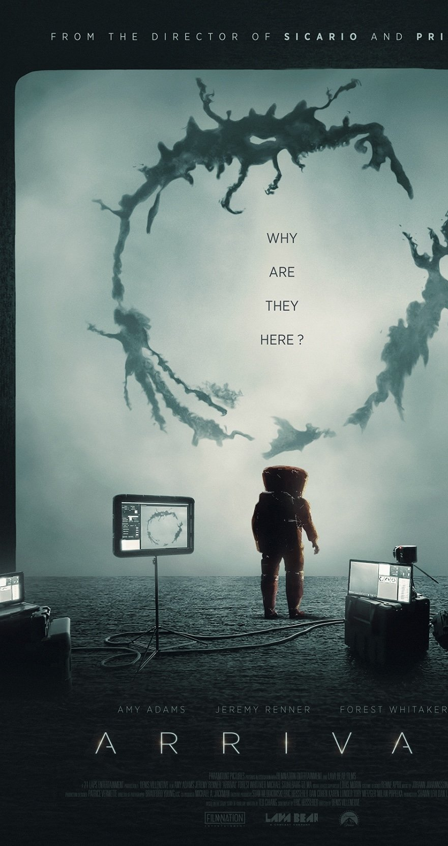
The Story: Decoding the Heptapod Language
• Linguist Dr. Louise Banks leads a team to communicate with alien visitors
• Aliens (Heptapods) use a circular, non-linear written language called Logograms
• Challenge: Understanding a language with no reference point to human communication
• Key Theme: Language shapes perception and thought (Sapir-Whorf hypothesis)
• Outcome: Understanding the alien language changes Louise's perception of time

Slide 4
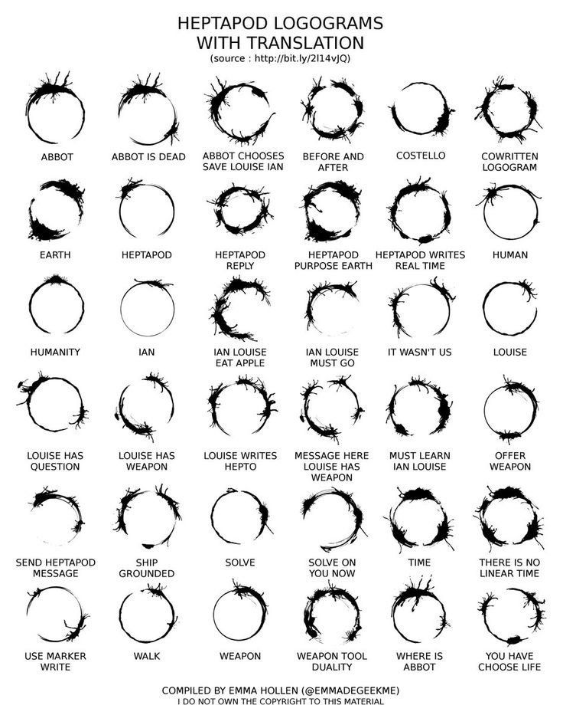
NLP Challenges in Arrival
Ambiguity – The word 'weapon' misunderstood as threat (semantic ambiguity)
Syntax & Structure – Heptapod language has no linear order, similar to parsing complex languages
Context & Meaning – Difficulty mapping symbols to concepts mirrors contextual NLP issues
Cultural Bias – Different worldviews resemble multilingual or cross-domain NLP problems

Slide 5
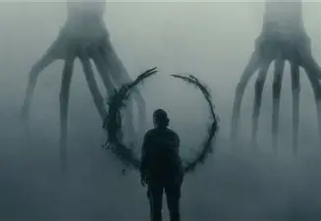

Scene Example and NLP Parallels
First Interaction – The Challenge of Unsupervised Learning
Scene: Banks and her team first meet the Heptapods behind a glass wall.
Problem: No shared language or reference pure unsupervised learning.
Heptapod Language: Circular ink logograms complex, non-linear symbols.
Human Attempt: Start with supervised methods showing labeled signs like “HUMAN,” but no way to confirm mutual understanding.

Slide 6

The Unsupervised Learning Problem
In machine learning, supervised learning involves using labeled examples to train a model. In contrast, unsupervised learning involves discovering patterns and structure within unlabeled data. Banks faces this challenge:
No Labels:There’s no dictionary or meaning guide just unknown symbols.
The “Chicken and Egg” Issue:Banks can’t ask big questions until both sides understand basic words.
Different Way of Thinking:The Heptapods’ language shows the whole idea at once, not word by word.
➜ Banks must turn this complex pattern into something humans can understand.

Slide 7
Dr. Banks’ Breakthrough
Learning by Doing:
She doesn’t use a dictionary, she learns by talking and trying again and again.
Spotting Patterns:
She looks at the symbols and finds what connects them to people and words.
Big Picture Thinking:
By fully learning their language, she starts to see time and ideas the way the aliens do.

Slide 8
Communication Methods & NLP Approaches
Rule-Based Approach – Louise begins by associating symbols with words (manual mapping)
Statistical Approach – Patterns emerge from frequency of symbols
Deep NLP – Contextual, holistic understanding mirrors neural networks
Visualization – Screen tools analogous to modern NLP visualization models like attention maps

Slide 9
Real-World NLP Tools and Techniques
Rule-Based NLP: spaCy, NLTK
Statistical NLP: Hidden Markov Models, n-grams
Deep NLP: Transformers (BERT, GPT)
Visualization: TensorFlow Playground, Attention Heatmaps
Notes:
Show how modern NLP tools mirror the progression Louise followed in decoding the alien language.

Slide 10
Reflections on Language and NLP
The film challenges our idea of linear language understanding
Demonstrates that true comprehension requires context and perception
Suggests that meaning is not just encoded but experienced
Raises questions about whether NLP can ever 'understand' meaning like humans do

Slide 11

Conclusion
Arrival bridges science fiction and linguistics to highlight communication barriers
1
Parallels with NLP emphasize challenges in semantics, context, and cultural bias
2
The movie inspires innovative thinking in AI and human-language interaction
3

Slide 12
References
Villeneuve, D. (Director). (2016). Arrival [Film]. Paramount Pictures.
Jurafsky, D., & Martin, J. H. (2023). Speech and Language Processing.
Course materials: ITAI 2376 – Challenges of Textual Data and NLP.

